Slide 1
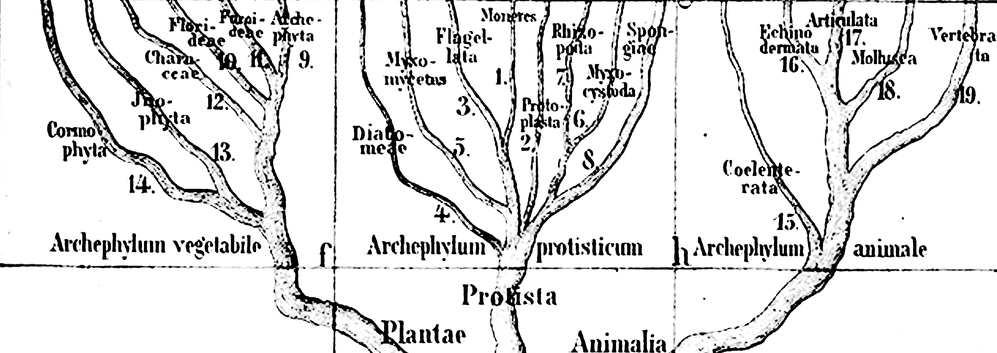
Module: Macroevolution
Ryan Folk – originally by Carolina Siniscalchi

Slide 2
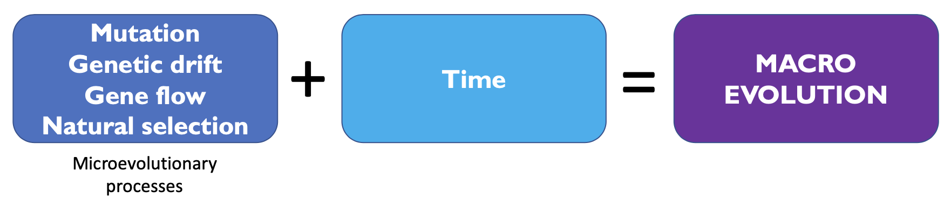
Macroevolution
Evolution above the species level (e.g., clade level)
Large-scale trends and transformations in evolution:
Radiation of flowering plants
Appearance of specific traits, e.g., nitrogen fixation

Slide 3
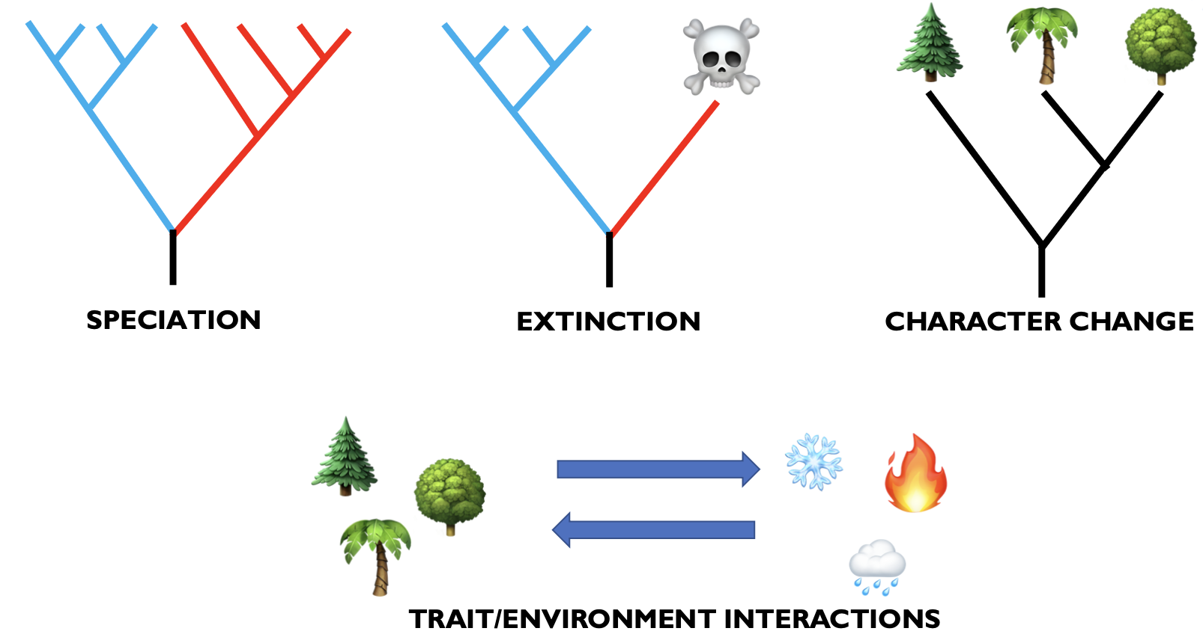
Macroevolution
Some processes that are commonly studied in macroevolutionary studies:

Slide 4
Macroevolution
Phylogenies are fundamental parts of macroevolutionary studies!
They provide a comparative framework in which we organize the information about the study organism
Phylogenies contain historical information we can use to test hypotheses (e.g., diversification rates, divergence times)

Slide 5
Macroevolution
What this talk IS NOT about:
How to assemble sequence data
How to get a phylogenetic tree, comparison of methods, orthologs and paralogs, gene tree discordance, &c.
How to date your tree or do biogeographical analysis
Philosophical discussions about macroevolution and criticism of methods
How to write code

Slide 6
Macroevolution
What this talk IS about:
Give a user perspective of basic steps on macroevolutionary analysis, including:
Types of data that are frequently used in macroevolutionary studies
How to organize your data and get it ready for analysis
Some examples of analysis that combine phylogenetic, environmental and trait data

Slide 7
Macroevolution
STEP ONE: TREE

Slide 8
STEP 1: TREE
Not a pdf with a tree figure on it
We need a text-style file that R (and other programs/languages) can understand
Newick (.tre, .tree, .nwk) or nexus (.nex)

Slide 9
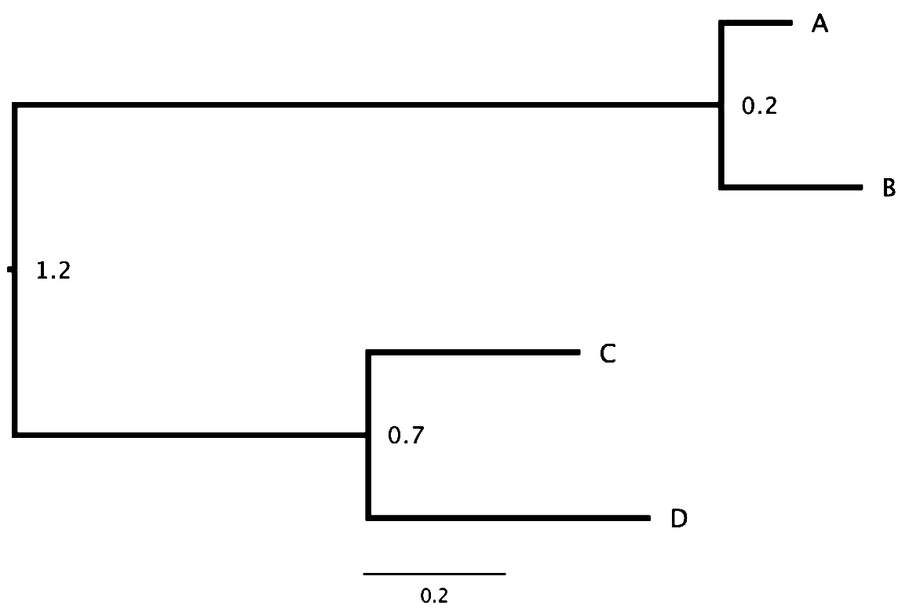
STEP 1: TREE
((A:0.1,B:0.2),(C:0.3,D:0.4):0.5);

Slide 10
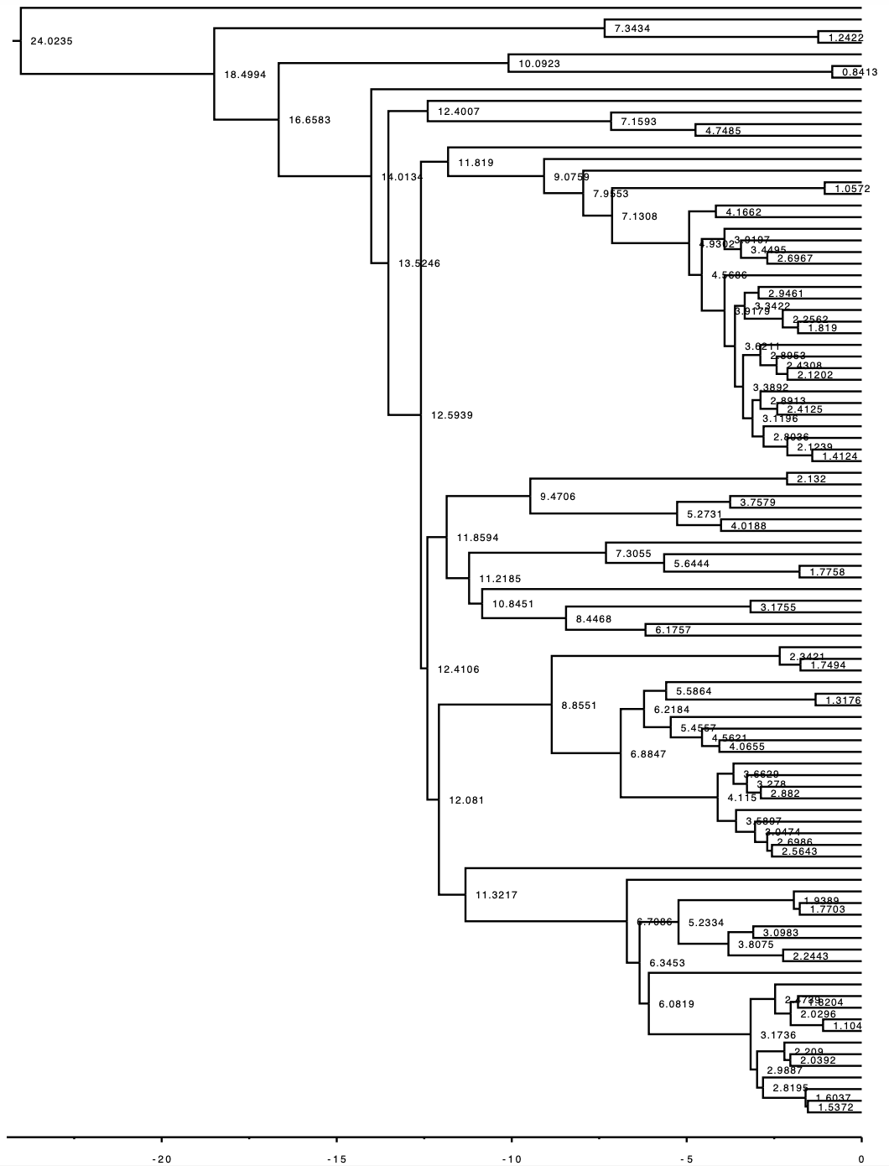
STEP 1: TREE
Methods that involve diversification rates need trees that are:
dated, ultrametric
fully bifurcating (no polytomies)
Methods are generally sensitive to sampling, so the completeness of your tree should be considered
Methods may or may not be sensitive to phylogenetic details; assumptions should be reviewed

Slide 11
Macroevolution
STEP TWO: ENVIRONMENTAL DATA

Slide 12
STEP 2: Environmental DATA
First things first: we need to know where our species of interest are found
Geographical records!
Where to find them?

Slide 13
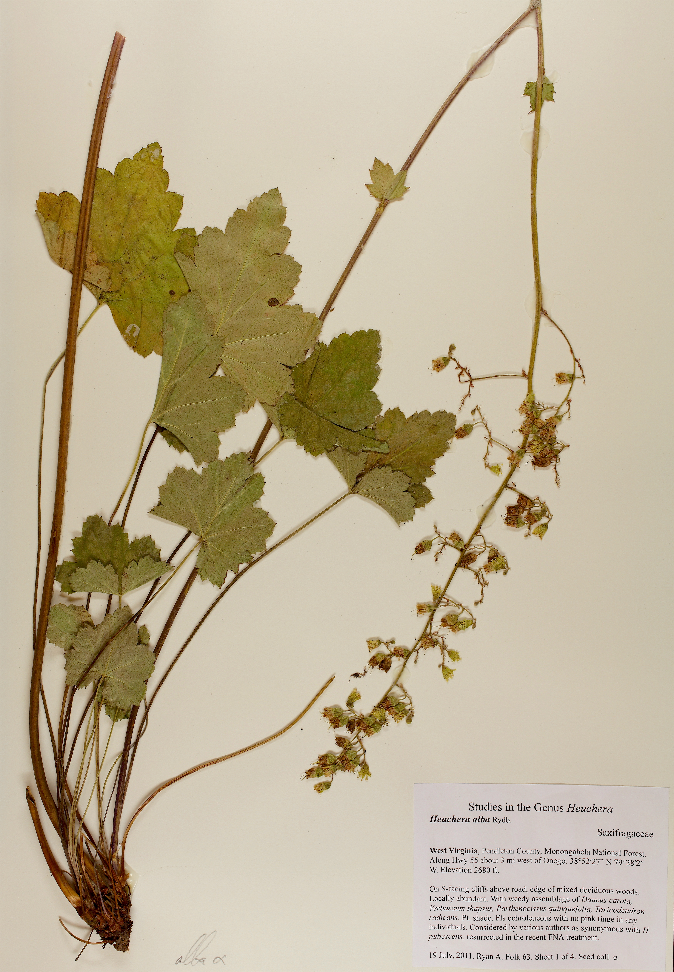
STEP 2: Environmental DATA
How to obtain geographical records: MUSEUM SPECIMENS
Coordinates on specimens
Georeferencing based on location (manually or with tools like GeoLocate)

Slide 14
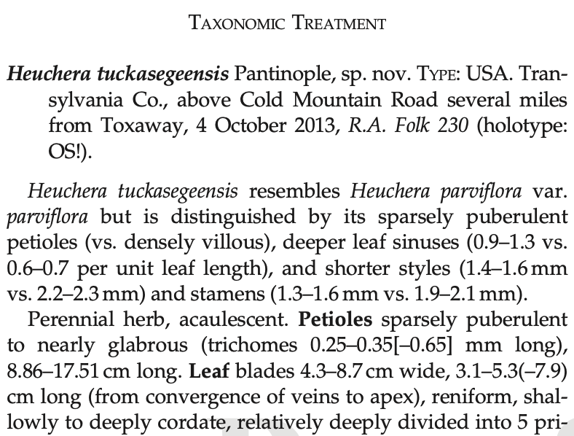
STEP 2: Environmental DATA
How to obtain geographical records: LITERATURE REVIEW
Species descriptions, monographs
Floras
Published range maps

Slide 15
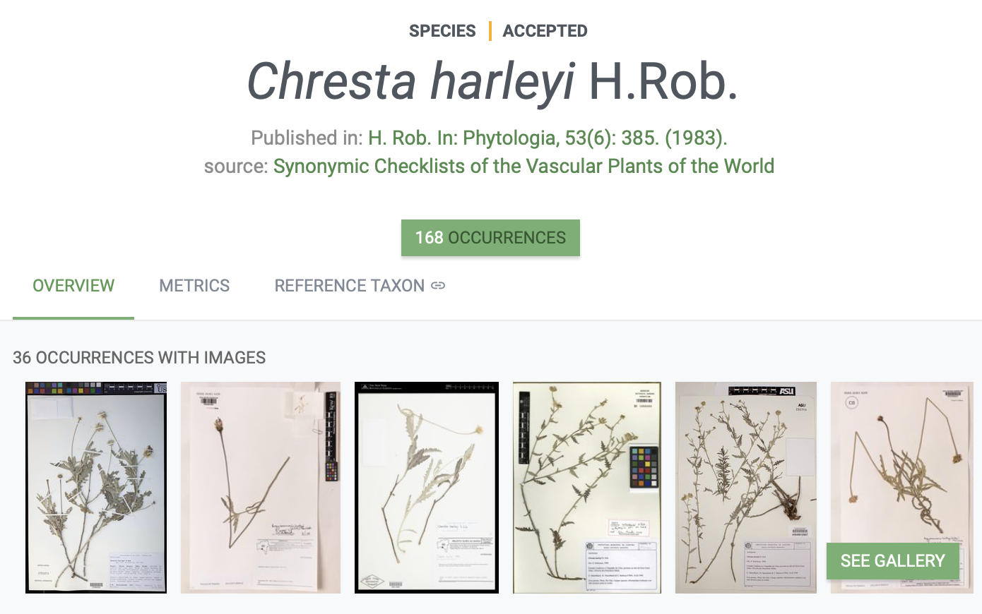
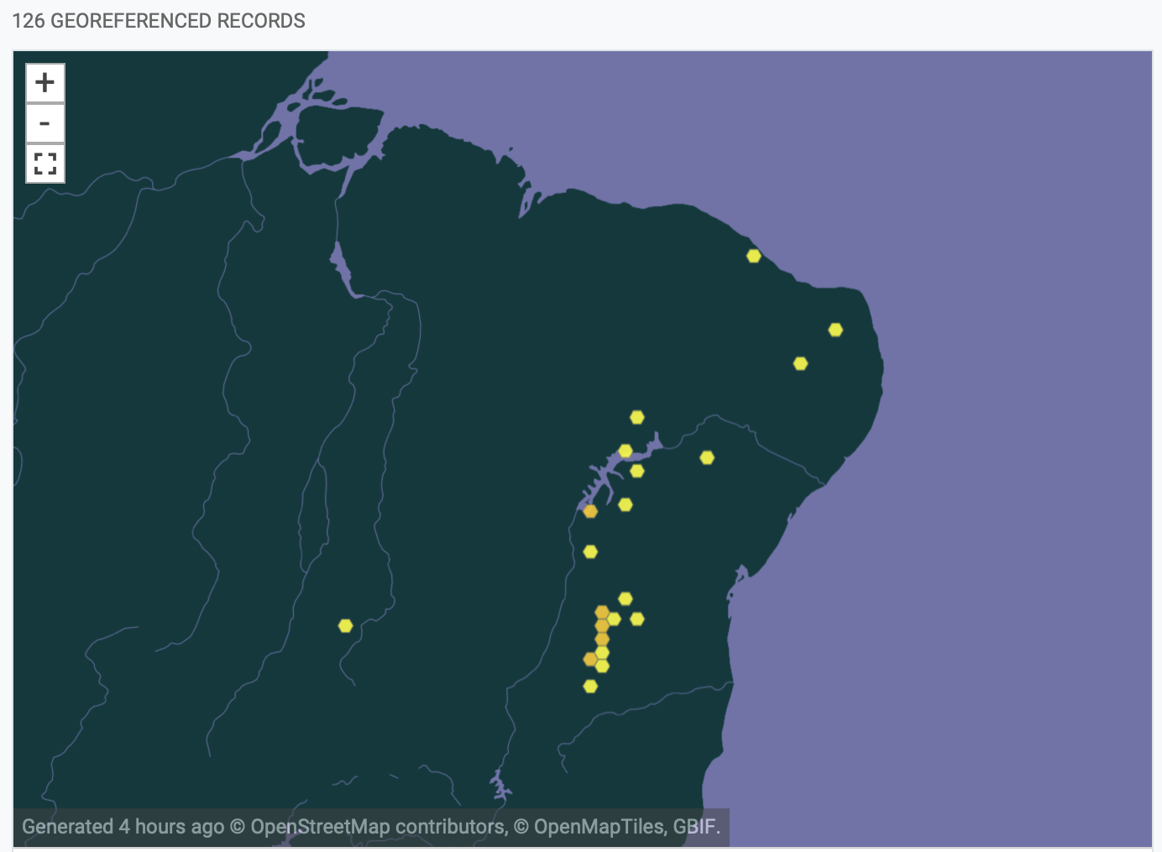
STEP 2: Environmental DATA
How to obtain geographical records: ONLINE REPOSITORIES
GBIF
iDigBio
iNaturalist (GBIF pulls records from there)

Slide 16
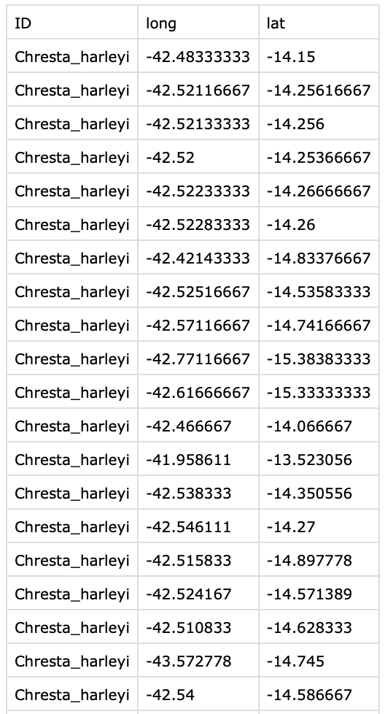
STEP 2: Environmental DATA
Always in decimal degrees
Record clean-up:
Remove duplicate values, outliers, records that fall in the wrong place (e.g., in the ocean, in the middle of a city), around botanical gardens/herbaria, &c.
Fancy new packages for doing this, e.g., CoordinateCleaner
Always save as a .csv or .tsv file, retain metadata records (e.g., citation info)

Slide 17
STEP 2: Environmental DATA
OK, I have my geographical records, what now?

Slide 18

STEP 2: Environmental DATA
High-resolution spatial data is increasingly becoming available for different variables
BIOCLIM: 19 climatic variables – data from weather stations interpolated with satellite images, with 1 km² resolution
Format: GeoTIFF (image file [tiff] that contains georeferencing information) or ASC (text file)

Slide 19

STEP 2: Environmental DATA
Other sources of spatial data:
GTOPO30: global digital elevation model (DEM; elevation, aspect, slope)
ISRIC SoilGrids: global digital mapping of soil characteristics (e.g., pH, carbon, nitrogen, sand, silt and clay content)
MODIS LandCover: global land cover classification (type of vegetation)

Slide 20
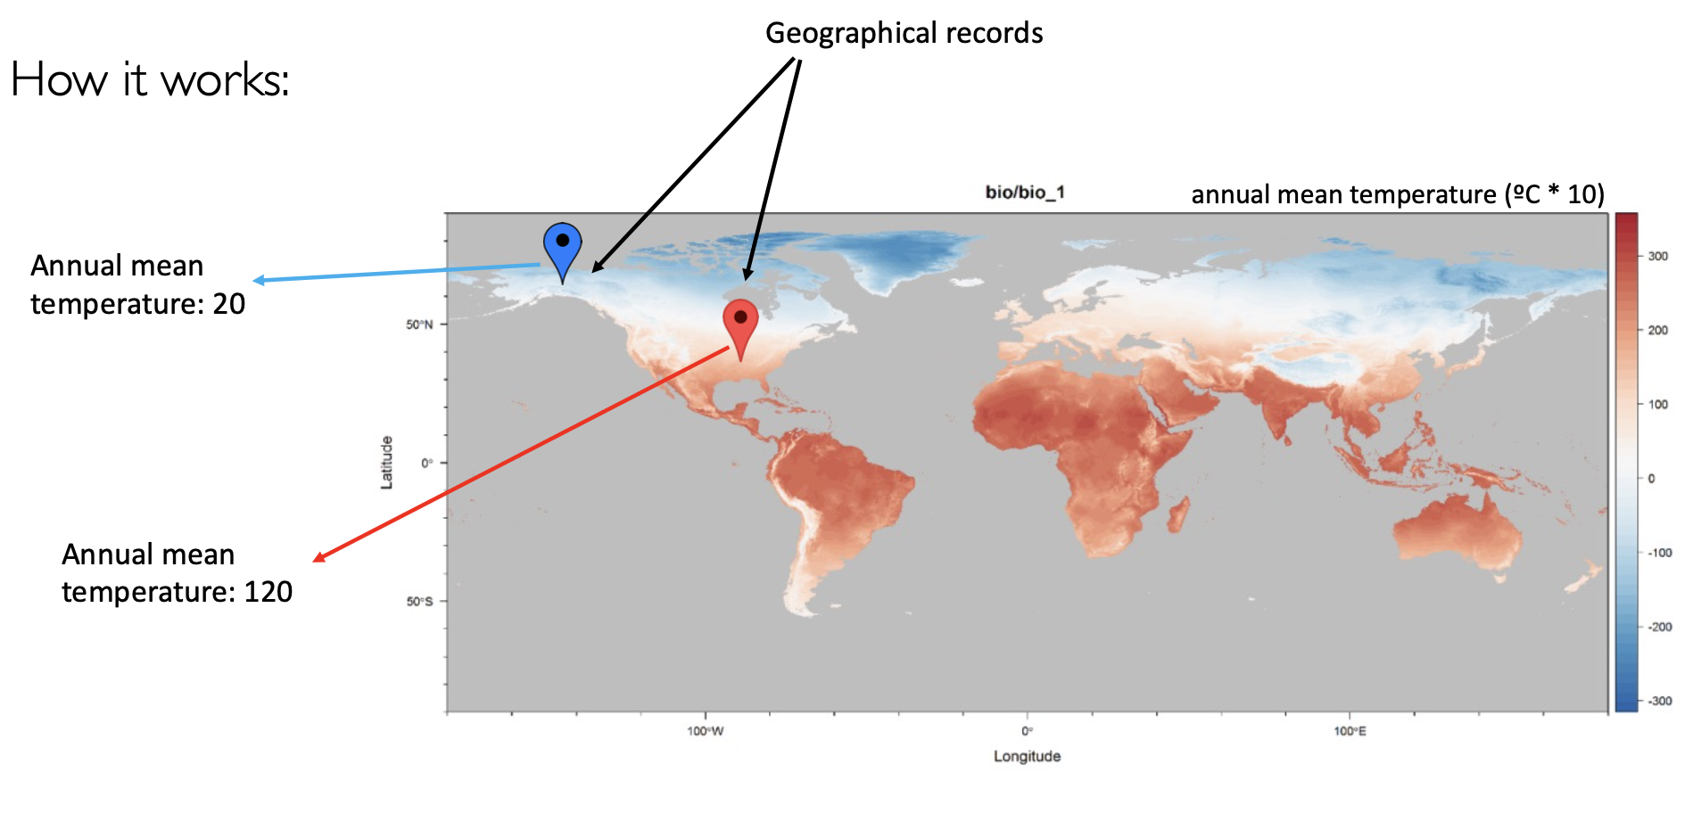
STEP 2: Environmental DATA

Slide 21
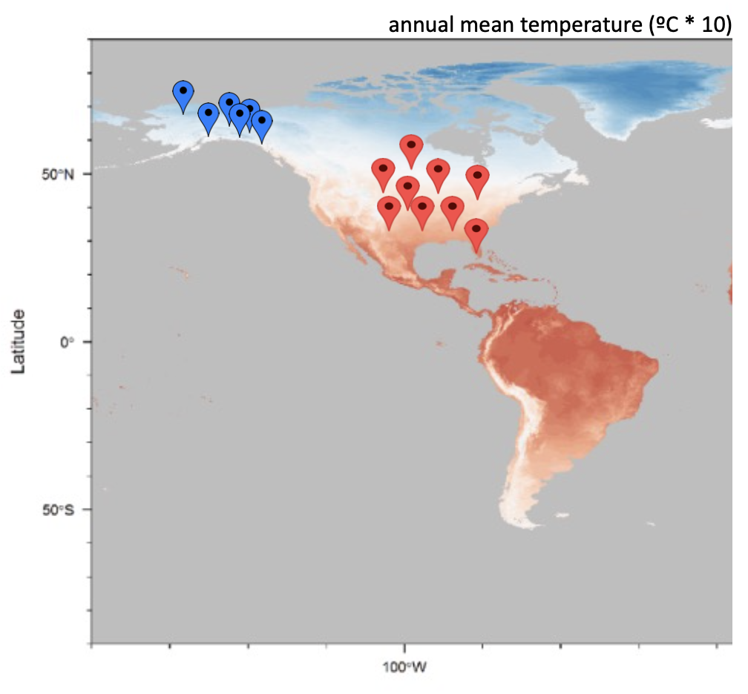
STEP 2: Environmental DATA
Look up the value of the variable in each geographical record of the species of interest
Calculate the average of the variable for that species – or other summary stats
Average species A: -0.5 °C Average species B: 8 °C
Rinse and repeat for all species/variables

Slide 22
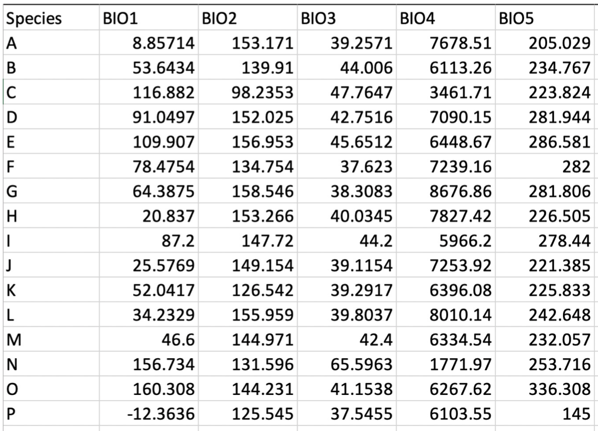
STEP 2: Environmental DATA
The final result will be a file/dataframe with values of all variables for all species
This process can be automated using custom python or R scripts

Slide 23
Macroevolution
STEP THREE: TRAIT DATA

Slide 24
STEP 3: Trait DATA
In macroevolutionary studies, we select traits that could potentially explain evolutionary processes in our group of interest, such as increased diversification and occupation of new habitats
Ex: Ancient and current polyploidy
Ex: Morphological changes that impact pollination and pollinator type
Ex: Changes in photosynthesis metabolism
Ex: Symbiosis

Slide 25
STEP 3: Trait DATA
Where to obtain traits?
Live and preserved specimens

Slide 26


STEP 3: Trait DATA
Where to obtain traits?
General databases (e.g., TRY, GIFT)

Slide 27
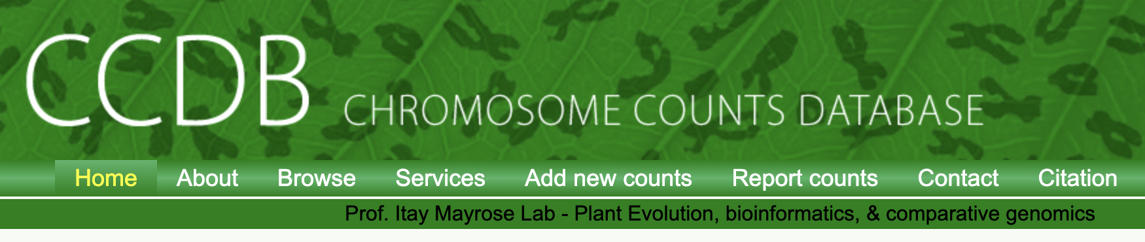
STEP 3: Trait DATA
Where to obtain traits?
Specialized databases (e.g., CCDB, genome size database)

Slide 28
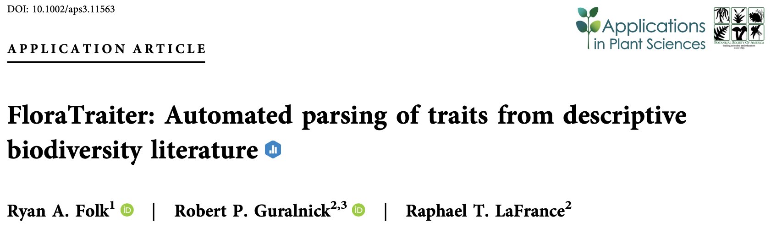
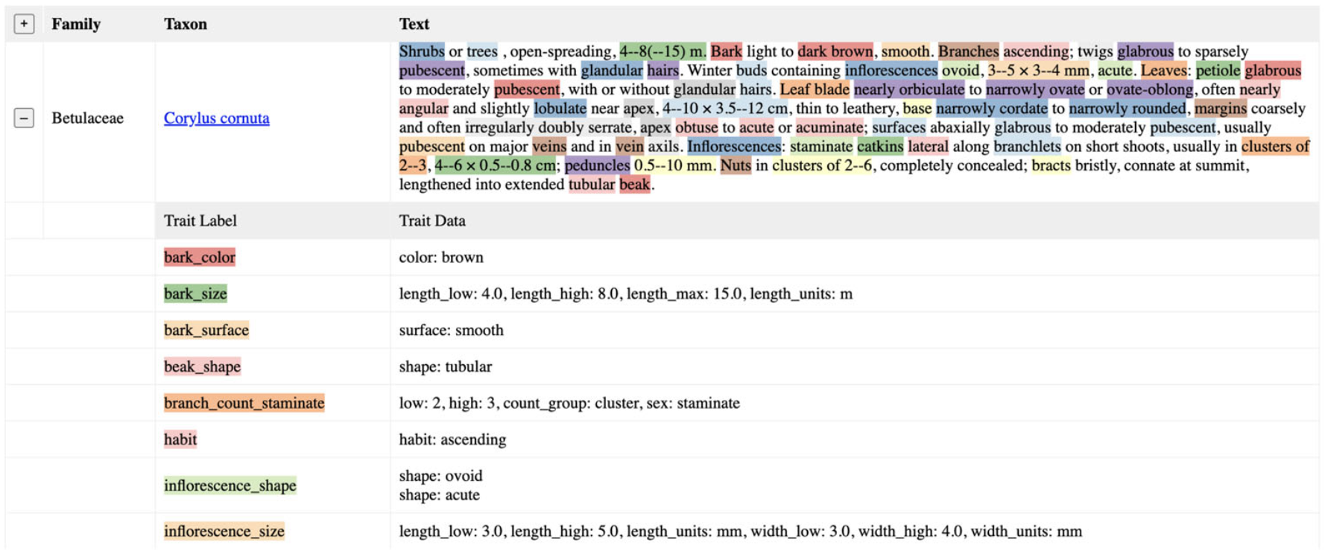
STEP 3: Trait DATA
Where to obtain traits?
Literature (monographs, floras)

Slide 29

STEP 3: Trait DATA
Where to obtain traits?
Specialized literature reviews (e.g., on symbiosis or isotopes)

Slide 30
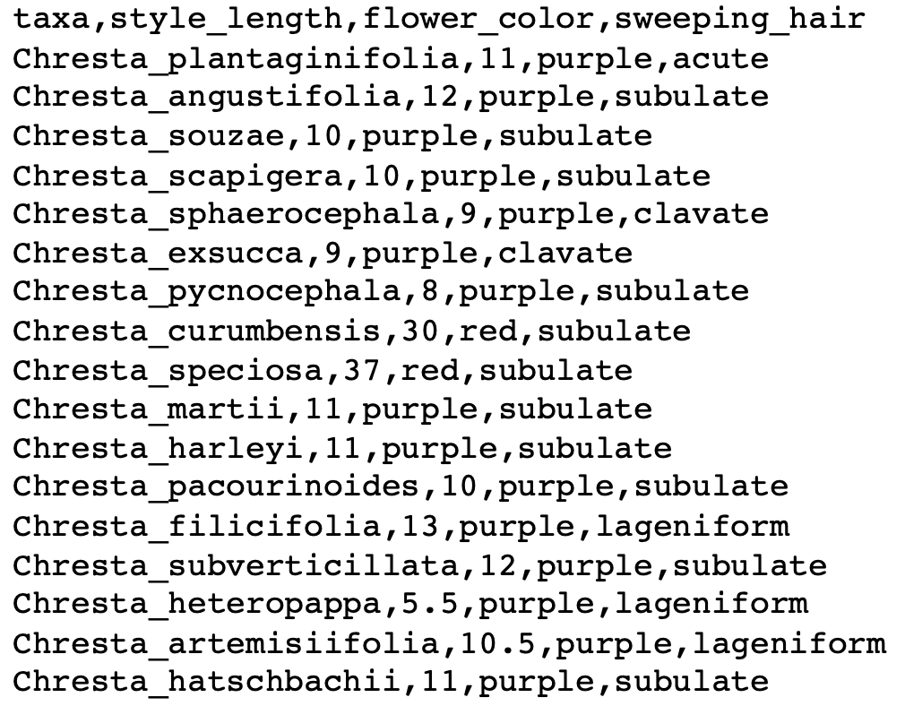
STEP 3: Trait DATA
Different types of trait data:
Discrete (binary or multi-state)
Continuous

Slide 31
STEP 3: Trait DATA
The type of trait data is essential in determining what type of analysis you can run
Many comparative methods are developed for only one type of data
E.g., different models must be fit for continuous/discrete data, with different resulting parameters
Some methods allow both types of data (e.g., PGLS)

Slide 32
Macroevolution
STEP 4: DO STUFF

Slide 33
MACROEVOLUTION
Some questions we can ask:
Is a certain trait related to changes in diversification rates?
Are certain environmental conditions related to shifts in diversification?
Is a certain trait related to shifts to different types of environment?
Are environmental shifts related to morphological changes?
Among many others....

Slide 34
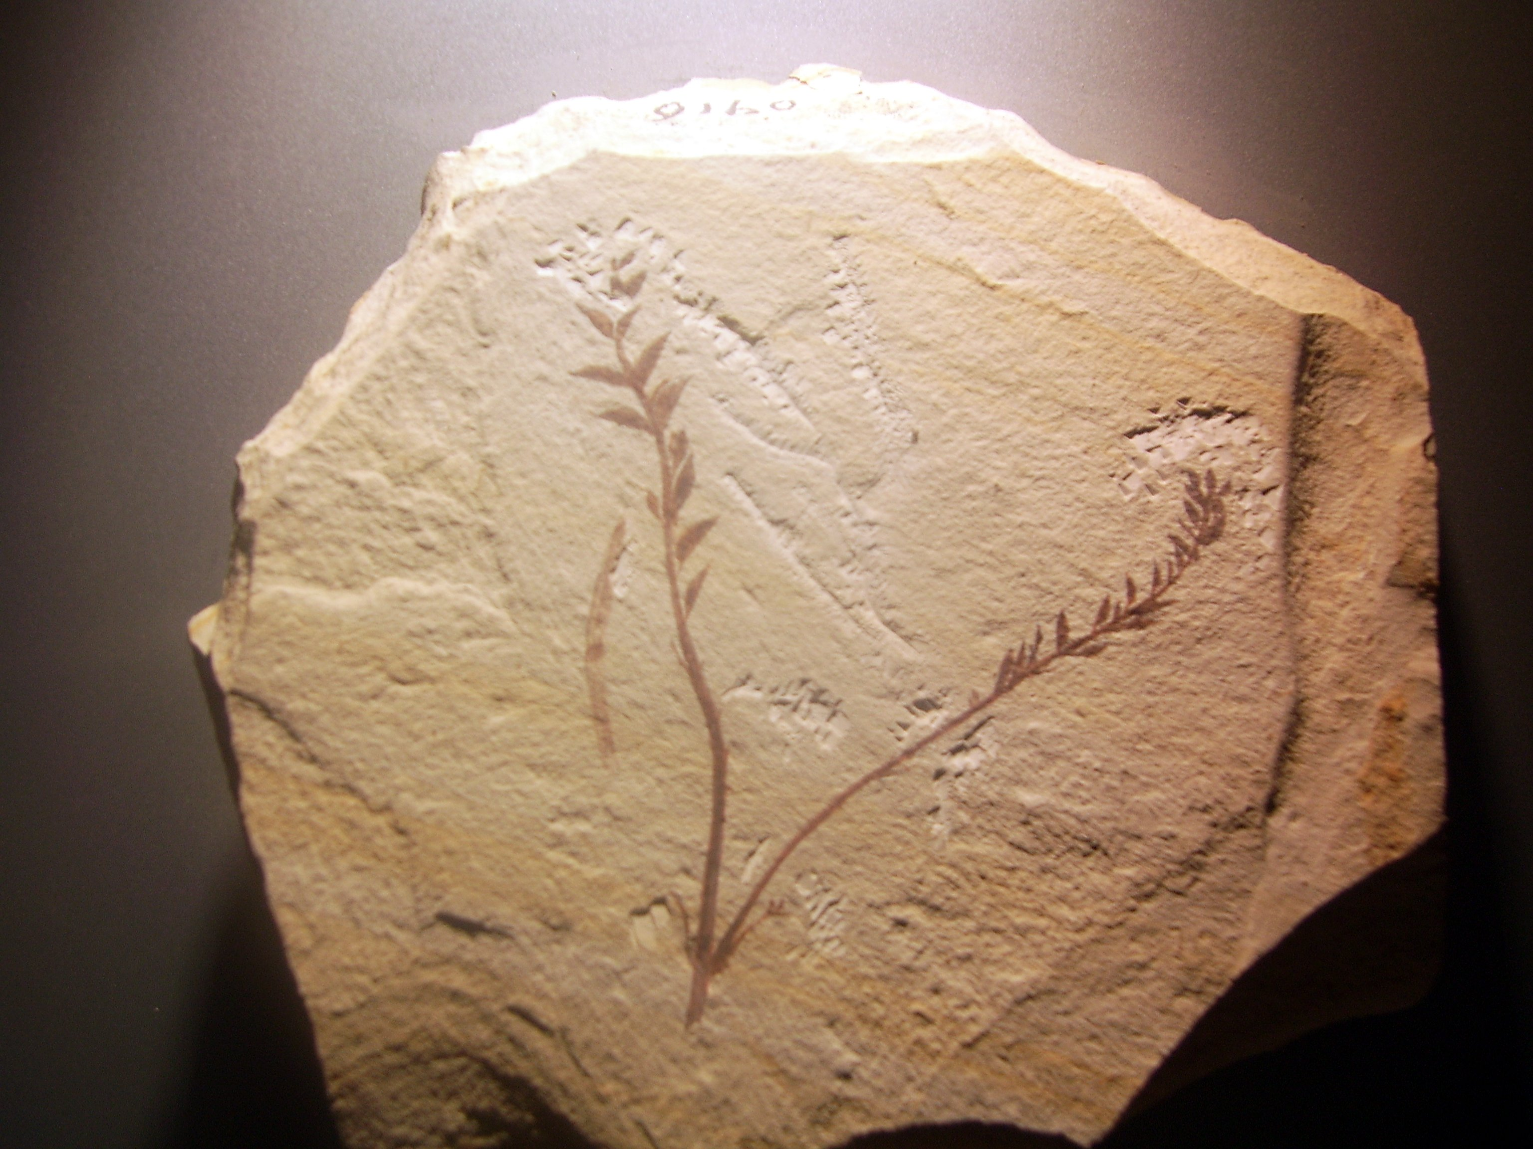
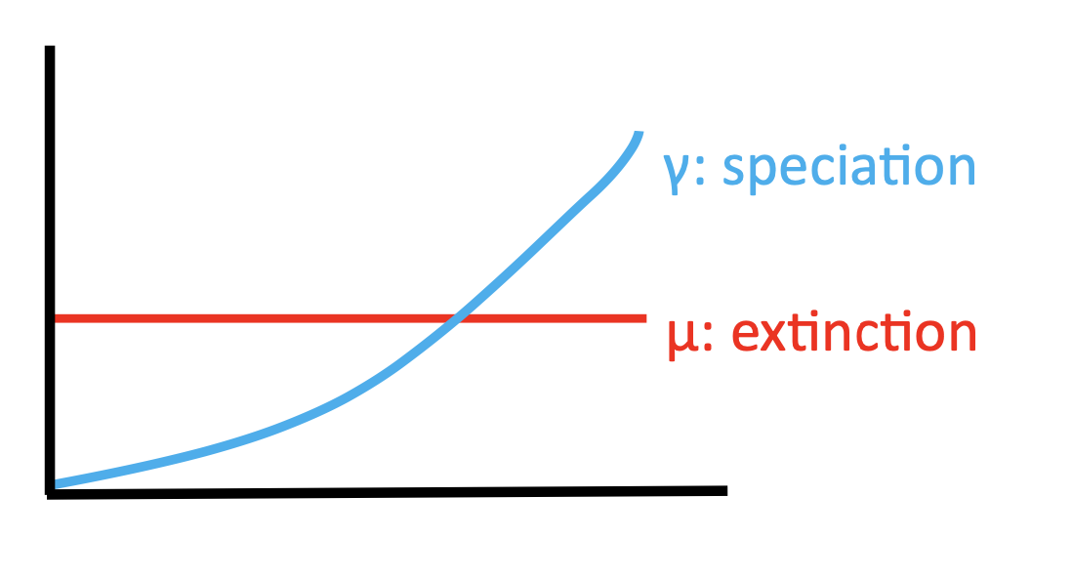
Diversification
What are diversification rates?
Rates at which new species form (speciation) and/or go extinct
Net diversification: speciation – extinction
Originally estimated directly from fossil time series
Phylogenetic trees – ability to infer for taxa without these data (most!!)

Slide 35
Diversification
Diversification rates are dependent both on:
Sampling (completeness of the tree)
Branch lengths (the distance among species on the tree)

Slide 36
Diversification
Diversification rates are dependent both on:
Sampling (completeness of the tree)
Branch lengths (the distance among species on the tree)
Methods
Infer diversification shifts:
BAMM (Bayesian estimation of different models of diversification)
RevBayes (another Bayesian implementation of many models)
MEDUSA (model choice under AIC)

Slide 37
Diversification
Methods
Map diversification rates (“tip rates”)
BAMM (Bayesian estimation of different models of diversification)
DR (non-parametric alternative)

Slide 38
Diversification
Methods
Test trait-associated diversification
BAMM/RevBayes
SSE-type models
Semi-parametric alternatives (FiSSE, ES-sim)

Slide 39
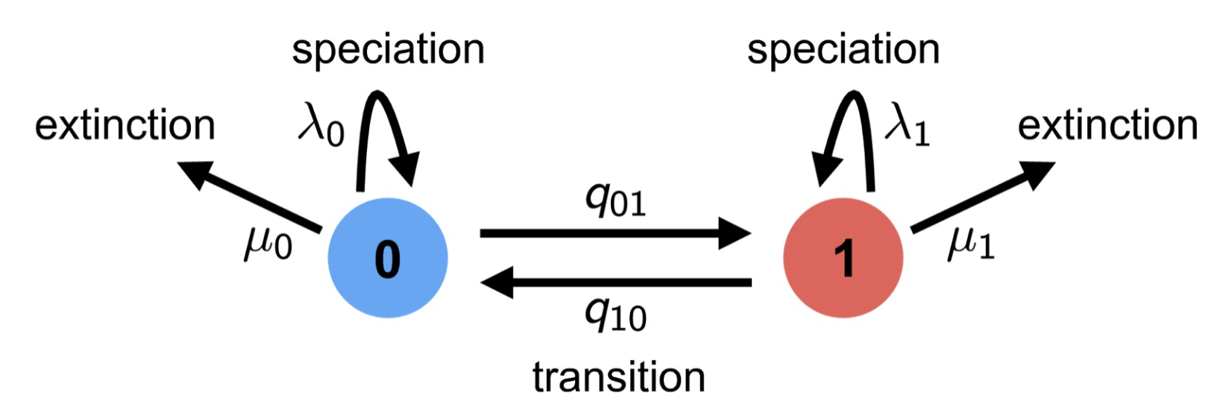

Diversification
SSE Models
Character state-dependent speciation and extinction
Birth-death process where the diversification rates are dependent on the state of an evolving character

Slide 40
Diversification
Standards:
BiSSE: binary discrete characters
MuSSE: multistate characters
ClaSSE: cladogenetic state change (biogeographic range evolution)
ChromoSSE: chromosome evolution
QuaSSE: quantitative speciation and extinction (continuous traits)

Slide 41
Diversification
Alternatives:
FiSSE: non-parametric test for binary characters
HiSSE: hidden-state speciation and extinction
Standard SSE models are prone to false positives (null model adequacy) and do not necessarily control phylogenetic pseudoreplication

Slide 42
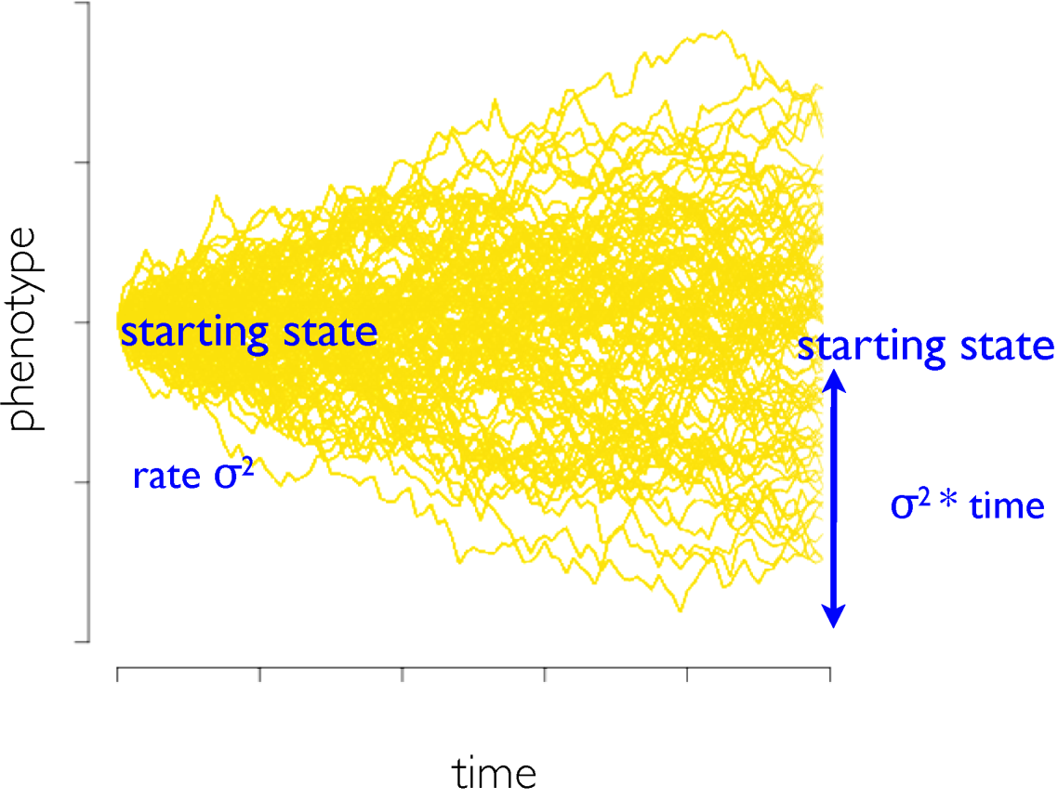
Evolutionary Models
Model selection: A single random drift process (Brownian motion) vs. stabilizing selection (Ornstein-Uhlenbeck) or early burst
Phytools
Model parameterization: Infer evolutionary rate(s) and optima
Underutilized – key concept
Ancestral reconstruction: Assumes the model!
http://phytools.org/mexico2018/lec/Cont-char-models.pdf

Slide 43
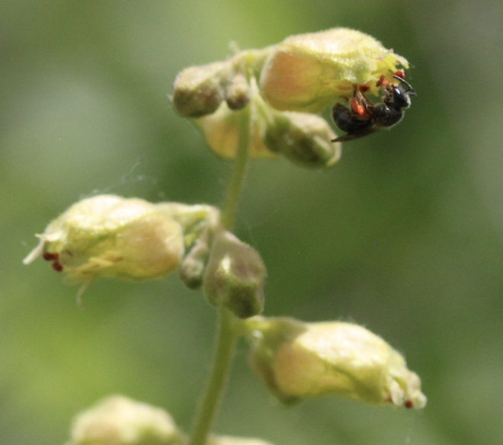
Evolutionary Models
We can use regressions to investigate if two variables are evolutionarily correlated, e.g.,
Is floral tube length related to nectar production?
Is a polyploidy associated to the occupation of drier environments?
Is nitrogen fixation related to poor soils?

Slide 44
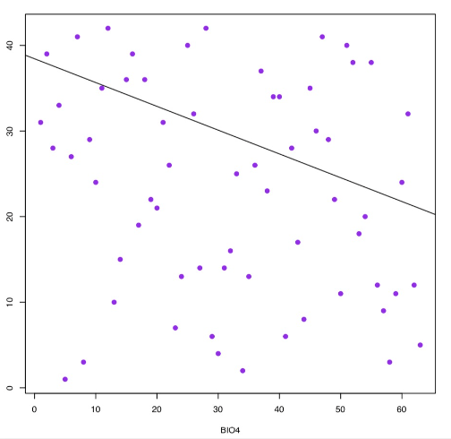
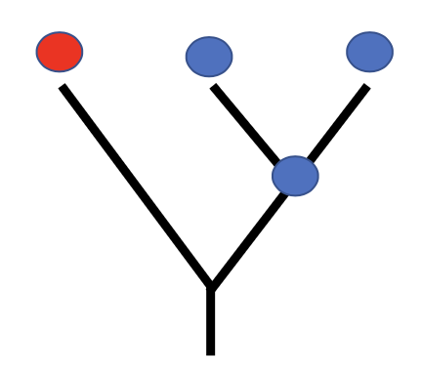
Evolutionary Models
We can use linear regressions to investigate if two variables are correlated
However, because of shared ancestry between species, they do not provide independent datapoints
Different aims from an evolutionary analysis

Slide 45
Evolutionary Models
PGLS is a modification of traditional generalized least squares
It assumes that closely related species will have more similar values under a model (Brownian evolution)
Accounts for specific autocorrelation due to phylogenetic history
Several ways to calculate, e.g., R package caper
Response variable: continuous trait
Predictor variable: continuous or binary discrete data

